Slide 1
CLOUDS IN SPACE: SCIENTIFIC COMPUTING USING WINDOWS AZURE
NITHIN D SOUZA
4SN16CS726
CSE ‘C’ Sec 4th Year
SIT Mangaluru

Slide 2
The space surveillance and tracking segment of ESA’s space situational awareness (SSA) system will provide vital security for space assets due to the increased awareness of the risks posed by space debris.
The requirements of the SSA system will grow as the population of space objects — and the threat they pose — increases into the future.
In this Seminar, we are going to discuss the relevance of a cloud-based architecture to SSA.
In particular, the cloud-based architecture is able to manage unpredictable computational demands, in response to a break-up event, in addition to the predictable requirements associated with the regular processing of a space object catalogue.

Slide 3
Advantages of using Azure for clouds in space
The ability to share data with trusted partners simply, rapidly and securely.
The partners, at their option, could then fund additional compute resources located close to the data to perform further analysis.
The data marketplace provided by Windows Azure is also potentially advantageous, in that it extends the concept of readily and securely sharing data to include the option for the data owner to monetise the data set, the income from which could fund additional analysis.

Slide 4
A cloud-based architecture solution to the SSA
This approach can only be successful if the objects that are targeted would otherwise contribute to future collision activity.
It does provide a more cost-effective approach to remediation than the removal of all debris objects.
However, this leads to a requirement that future collisions are forecast to a sufficient accuracy.
In addition, to limit the generation of more debris and to reduce costs further, it is likely that an ADR(Active Debris Removal) mission will aim to remove more than one debris object.

Slide 5
Active Debris Removal architecture
A key concern in the design of an ADR mission will arise from the choice of propulsion system.
The choice will be determined, in part, by the energy required to remove debris targets from orbit and to transfer to subsequent targets.
The ADR architecture generates data which is stored in cloud-storage. Accessing the raw data from cloud-storage is trivial and we utilise World Wide Telescope (WWT) to visualise the input, output and intermediate files.
WWT has a rich API which supports importing data via a REST interface or from Excel, and is used to visualise data directly from Windows Azure.

Slide 6
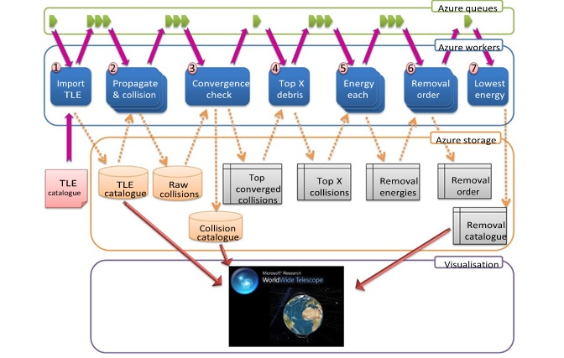

Slide 7
Scientists and engineers use a similar paradigm to make use of massive amounts of compute and data handling resources provided by companies such as Amazon, Microsoft and Google.
One of the key architecture patterns for cloud computing is to decouple a problem into independent discrete operations, and implement each with a worker.
Each message is a discrete piece of work which can result in data being created or consumed from storage (tables, SQL, blobs) the output message indicates work that has been completed and can easily become the input for another worker.
This architecture is very flexible as workers can be reordered or substituted to achieve different objectives, or as a queue starts to get too long more workers of the same type can be created, speeding up the overall process.

Slide 8
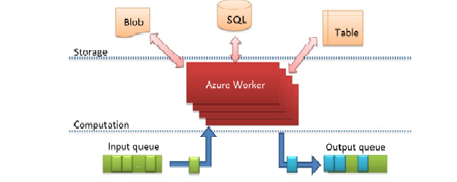
Azure worker architecture pattern

Slide 9
Data dissemination
Cloud offerings are inherently global, highly available and have large bandwidth capabilities, making them ideal for data aggregation and dissemination.
Often sharing data involves copying the data (perhaps multiple times) to ensure that the data and compute reside near each other but using a cloud-based resource, sharing can be as simple as changing access permissions.
Once a dataset resides in a globally accessible cloud resource it too becomes a valuable resource suitable for third party data mashups.
The data owner can provide access to a third party, who can purchase compute resources with the same cloud provider and immediately start processing the data set.

Slide 10
Burst capability
A data centre copes with predictable demand and unpredictable demand.
When sizing a data centre for such a scenario it has to be able to cope with the peak load for the majority of the time this hardware remains unused.
Where the data centre can cope with demand, the end user applications are unaffected.
Once the demand exceeds the capability of the data centre, the under-resourced demand has a negative impact on the end user application.
Moving such an application to a cloud provider ensures that you only incur costs for the resources utilised, whilst enabling rapid scaling to deal with a variable demand level.

Slide 11
Super-Scalability
The current debris catalogue size is limited by the ability to track distant or small objects.
As detection methods improved the expect to track a wider range of debris. This will vastly increase the debris catalogue.
Currently the catalogue contains approximately 20000 objects but there are millions of objects that could be tracked.
This ability to purchase additional compute power in a flexible way means that a cloud-based infrastructure can be scaled to provide a continuity of awareness as the population of space objects and the SST measurement hardware evolve over time.

Slide 12
Application
Scaling up
Scaling down

Slide 13
Scaling up
Scaling up by procuring a more powerful computational resource.
Scaling up is the most common method to improve performance, but is restricted by the capabilities of the most powerful hardware the evolution of hardware performance should also be considered.
Migrating existing solutions to more powerful hardware is a well understood problem and is particularly applicable where the task cannot easily be decomposed into smaller units of work.

Slide 14
Scaling out
Scale-out often requires more development effort than migrating to a scale-up method.
Dividing a task across multiple computational resources incurs an overhead, thus limiting the theoretical improvement in performance as more resources are added.
Complex units of work consume tasks from a queue, which makes scaling-out easier since the number of workers consuming tasks from a queue can be varied with the length of the queue.

Slide 15
The cloud-based solution provides additional advantages, including the ability to share data with trusted partners simply, rapidly and securely.
The partners, at their option, could then fund additional compute resources located close to the data to perform further analysis.
The data marketplace provided by Windows Azure is also potentially advantageous, in that it extends the concept of readily and securely sharing data to include the option for the data owner to monetise the data set, the income from which could fund additional analysis.

Slide 16
Conclusion
a cloud based architecture using Microsoft Windows Azure can be successfully applied to an active debris removal mission design task, developed a modular architecture which will be used in the future to support other SSA activities.
The modular, cloud-based nature of this solution gives it some unique advantages over alternative architectures due to the rapid availability of huge computational and data storage resources.
Due to the simplicity that it brings to securely sharing raw or processed data and due to the ease with which it facilitates the side-by-side comparison of alternative algorithms.

Slide 17
THANK YOU

